Slide 1
ENVIRONMENTAL ECONOMIC ACCOUNTING BOTSWANA EXPERIENCE
Mr. Dimpho Galegane
Ministry Of Land Management, Water And Sanitation Services
Department Of Water Affairs

Slide 2
OUTLINE
Background
Issues and Challenges
Benefits of EEA
Methodology
Data needs and data providers
Highlights from the Accounts
Achievements
Ongoing work/ Future plans
Conclusion

Slide 3
BACKGROUND
Botswana embraced Environmental Economic Accounting (EEA) following the outcome of the Gaborone Declaration for Sustainability in Africa (GDSA) in 2012.
Prioritized accounts: water, minerals and energy resources, including compilation of macroeconomic indicators of sustainable development.
Capacity building and a process to institutionalize the accounts was led by government, with support from the World Bank, through the Wealth Accounting and Valuation of Ecosystem Services (WAVES) programme.
WAVES - aims to promote sustainable development by mainstreaming natural capital in development planning and national economic accounting systems.
WAVES support ended in June 2016.

Slide 4
ISSUES AND CHALLENGES
Limited (scarce) water resources – Botswana is a semi arid country with a mean annual rainfall of around 450mm.
Power shortage – For years Botswana has been importing most of its electricity from neighbouring countries.
Reliance on mineral resources – Minerals (mostly diamonds) are the backbone of Botswana’s economy.
This issues make the compilation of the accounts relevant, because its only when we begin to monitor the flows and the stocks of our natural resources that we would be able to manage them properly.
EEA PRIORITIES IN BOTSWANA
Water Accounts: To better assess the availability, uses and economic contribution of water.
Mineral Accounts: To help ensure appropriate decisions are made regarding the investment of mineral revenues to provide for future economic growth.
Energy Accounts: To provide systematic resource information about the use and supply of energy.

Slide 5
METHODOLOGY
Botswana adopted the UN methodology of the System of Environmental Economic Accounting (SEEA).
SEEA central framework is a multipurpose conceptual framework for understanding the interactions between the environment and the economy.
SEEA-water;- contains standard concepts and methods for water accounting.
SEEA-energy;- multi-purpose framework which organizes energy-related statistics.
Environmental Accounts compiled include:
Water Accounts – Physical supply and use tables and Assets accounts.
Energy Accounts – Physical supply and use Tables.
Mineral Accounts – Physical and monetary asset accounts.

Slide 6
DATA NEEDS AND DATA PROVIDERS
Environmental Accounting is a data intensive process with numerous data providers.
Multi-sectoral TWGs - assist in timely supply of relevant data and provide technical input in the analysis of the results generated by various component accounts.
Data clean up, sorting and analysis with feedback to data providers to ensure credibility.
Seminars and workshops for stakeholders conducted to build capacity and share results from the accounts.
Some of the key data providers include:
Statistics Botswana - GDP, Value added and Employment data.
Mining companies - Production data.
Water service provider - Annual water abstraction, return flows, sales data, etc
Botswana Power Corporation – Electricity generation and coal sales data.
Surveys – Surveys are carried out to acquire unavailable data.
e.g. Annual irrigation survey and National energy use survey

Slide 7
Detailed example from Water Accounts
Organisation | Data required
Ministry of Agriculture (MoA) | Irrigated area per annum, technology, water use by source, production, Number of livestock per annum Number and capacity of agricultural dams, annual water storage & use Costs & revenues of agricultural dams & irrigation schemes
Mining Companies | Annual water abstraction, return flows, water supplied to/from other economic sectors Costs of water abstraction p.a., Capital expediture p.a
Energy Industry (BPC) | Annual water abstraction, return flows, water supplied to/from other economic sectors Costs of water abstraction p.a., Capital expediture p.a
Statistics Botswana | Value added by economic sector and year Employment by economic sector and year Population Census figures on population numbers and access to water & sanitation.
Water Service Providers (WUC) | Annual water abstraction, return flows, water supplied to/from other economic sectors, Client categorised by economic sector, water sales by economic sector, exports and imports by MC, Waste water, Dam levels, inflows and abstractions O&M expediture p.a., Capital expediture p.a
Water Service Providers (DWA & PMO) | WAB Reports, Dam inflows, evapotranspiration calculations, safe yield monitoring for ground and surface water, transboundary water balances, soil moisture modeling, O&M expenditure p.a, Capital expenditure p.a

Slide 8
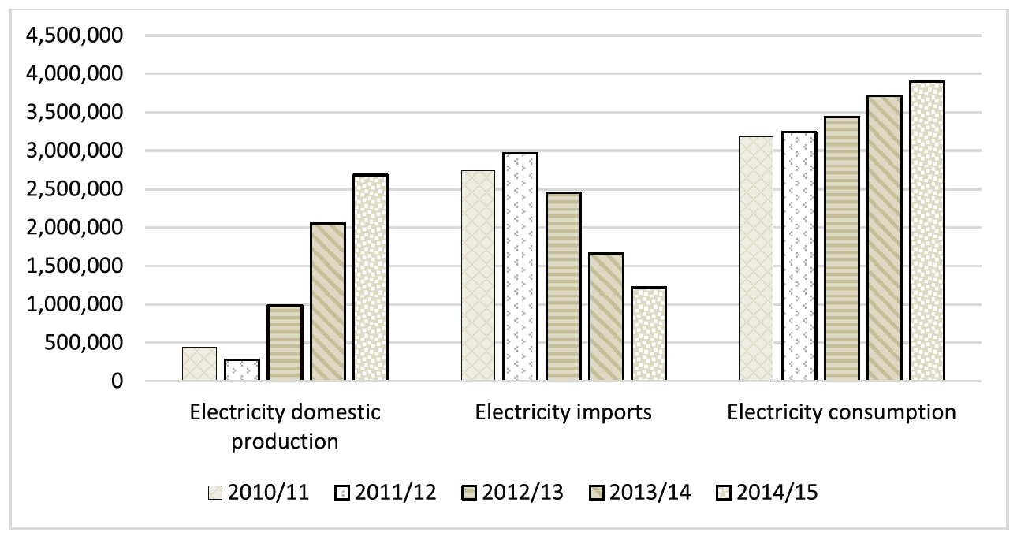
HIGHLIGHTS FROM THE ACCOUNTS
Water consumption by economic sector, 2013-14, 2014-15 and 2015-16 (MCM)
Trends in Electricity production, imports and Use (MWh)

Slide 9
ACHIEVEMENTS
The country has fully institutionalized the accounts with 4 operational accounting units (Water, Energy, Minerals and Macro economic indicators unit).
Each accounting component has made substantial progress so far:
Water accounts – 4 technical reports produced. Assets accounts and physical supply and use tables.
Mineral accounts – 2 reports – covers 5 mined commodities (diamonds, copper-nickel, coal, gold & soda ash).
Energy accounts – 2 reports – accounts for electricity & coal.
Macroeconomic indicators of sustainable development - 3 reports produced.
Besides technical reports; policy briefs, case studies and academic papers have been produced by various EEA teams.

Slide 10
BENEFITS OF EEA
Better management/ utilisation of available resource - The water accounts identified usage of treated effluent as been very low and proposed optimized usage of treated effluent as a demand management strategy (Only 2MCM of the available 40MCM treated effluent is utilized for irrigation).
Water use efficiency computations helped to identify economic sectors to target for water conservation and demand management.
Inform different policy relevant projects. Time series data used to compute long term demand projections in the National Water Master Plan Review.
Monitoring of SDGs. E.g SDG indicators 6.4.1 and 6.4.2 – Water accounts provided information on water use efficiency, water abstraction and water used by different economic sectors.

Slide 11
ONGOING WORK
Implementing sectors continue to update accounts on annual basis.
Stakeholder workshops are held annually to share results derived from the accounts.
Technical reports are also produced on annual basis and published on the WAVES website (www.wavespartnership.org).
Future plans
Botswana seek to expand the accounts to include compilation of Ecosystem and Tourism Accounts. Scoping study done for ecosystem and Tourism accounts .
Expansion of the existing Accounts, to include;
Water Accounts: Full monetary accounts, ground water stocks, wastewater accounts.
Energy Accounts: to include liquid fuels.

Slide 12
CONCLUSION
Through the WAVES program, accounts have been fully institutionalised in different implementing ministries and updating of the accounts is done annually.
Institutionalisation – It was made possible by government buy in and commitment to support environmental accounting activities after WAVES support ended.
Establishment of Technical Working groups assist in timely submission of data and the review of the final reports.
Need to establish EEA community of practitioners in Africa, in order to share ideas and experiences.
Environmental Economic Accounting training is needed to build capacity amongst African countries.

Slide 13
Thank you

