Slide 1
GDP REBASING AND
RE-BENCHMARKING:
The Nigerian Experience
Dr. Yemi Kale
Statistician-General of the Federation
National Bureau of Statistics, Abuja

Slide 2
Contents
Background
Process
Key results (and how it affected policy issues)
Lessons learned
Conclusion

Slide 3
Background

Slide 4
Rebasing / re-benchmarking?
Completed in 2014 with base year updated from 1990 to 2010
Economic activities increased from 33 to 46
Transition to SNA 2008
Rebasing
- replacing the present price structure with a new or more recent price structure of the base year. This involves:
Changing price and quantity base for individual price and quantity relatives
Updating weights
Re-benchmarking:
involves incorporating those economic activities which were not in existence at the old base year, or were not being adequately captured within the GDP compilation framework

Slide 5
Why GDP rebasing / re-benchmarking?
Economies are dynamic: growth, recession
Over time, prices change and the structure of an economy changes
introduction of new products
alteration in the variety of products and services due to technological innovations and developments
Changes in consumption
Price structure of the economy changes
base year structure becomes less representative of the economy as time progresses
substitution effect: Consumers move away from relatively more expensive products to buy goods with relatively cheaper prices.

Slide 6
Key benefits
Enables policy makers, analysts investors etc to obtain a more accurate picture and a better understanding of economic structure
Inform policy decisions and program design
System of National Accounts (SNA2008) recommends rebasing every 5 years but…
some countries keep the same base period for as many as 10 years or 5 years, and some changing the base period every year

Slide 7
Process

Slide 8
Country comparison of base year*
8
Country | Old Base Year | New Base Year | Number of years between base years | % Difference in GDP after rebasing
Argentina | 1986 | 1993 | 7 | -8.2
Botswana | 1993/1994 | 2006 | 13 | -10
Chile | 1986 | 1996 | 10 | 9.9
Guatemala | 1958 | 2001 | 43 | -10.7
Honduras | 1978 | 2000 | 22 | 19.2
Lesotho | 1995 | 2004 | 9 | -4.4
Morocco | 1988 | 1998 | 10 | 11.7
Nicaragua | 1980 | 1994 | 14 | 70.0
Niger | 1987 | 2006 | 19 | 2.5
Nigeria | 1990 | 2010 | 24 | ???
Paraguay | 1982 | 1994 | 12 | -11.6
Sierra Leone | 2001 | 2006 | 5 | 25.6
Tanzania | 2001 | 2007 | 6 | 10
Tunisia | 1990 | 1997 | 7 | 9.8
Uganda | 1997/1998 | 2002 | 5 | 10.5
Venezuela | 1984 | 1997 | 13 | -3.2
*as at April 2014

Slide 9
Key activities undertaken
9
Four major methodological pillars
The System of National Accounts (SNA 2008 version),
The International Standard Industrial Classification (ISIC Revision 4),
The Central Product Classification (CPC version 2)
The development of a Supply and Use Table/matrix (SUT)
NBS conducted 14 sector surveys
Additional data collected from various MDAs, and private businesses:
FIRS, MoF, SEC,CBN, Customs, MAN, REDAN, NEITI, MTN, Validation by International and Domestic experts
IMF, World Bank, ADB, 6 renowned economists

Slide 10
Sector surveys included:
1. Mining and Quarrying
2. Manufacturing
3. Construction
4. Wholesale & Retail Trade, Repair of motor vehicles & motor cycles
5. Transportation & Storage
6. Accommodation & Food service activities
7. Information & Communication
8. Real Estate activities
9. Professional ,Scientific & Technical activities
10. Administrative & Support Service activities
11. Education
12. Human Health and Social Work activities
13. Arts & Entertainment
14. Other Service activities

Slide 11
Additional administrative data collection
Additional supplemental data gathering was conducted along with the FIRS and other MDAs
They supplied data on:
Electricity
Gas, Steam & Air conditioning Supply
Water Supply, Sewage, Waste Management and remediation activities
Oil marketing activities

Slide 12
Updates to NBS survey frames
The previous survey frame was merged with the list of establishments obtained from the Federal Inland Revenue Service (FIRS)
In the end, a total of 851,628 establishments were in the frame compared to 83,733
The survey frame was then used for the sampling and selection of units

Slide 13
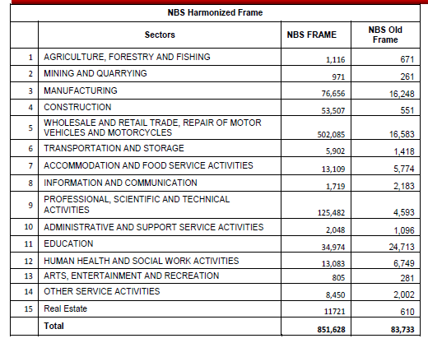
Updates to survey frames

Slide 14
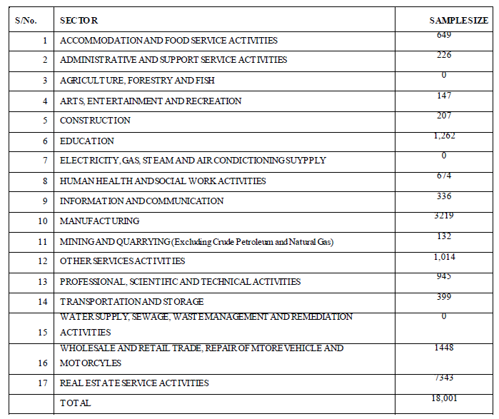
… and selection of sample

Slide 15
Key results

Slide 16
Key results
 | Old Series (N, Million, Current Prices)
 | 2010 | 2011 | 2012 | 2013F
Agriculture | 10,310,655.64 | 11,593,434.13 | 13,413,842.46 | 14,709,104.92
Industry | 15,659,521.00 | 16,569,291.58 | 16,456,457.10 | 15,374,554.67
Services | 8,014,577.50 | 9,247,134.90 | 10,673,800.38 | 12,313,106.11
TOTAL | 33,984,754.13 | 37,409,860.61 | 40,544,099.94 | 42,396,765.71
Nominal GDP (2013) est.: N80.1trillion
New Series (N, Million, Current Prices)
 | 2010 | 2011 | 2012 | 2013
Agriculture | 13,048,892.80 | 14,037,825.84 | 15,815,997.51 | 16,816,553.01
Industry | 13,826,433.90 | 17,853,113.99 | 19,587,721.32 | 20,853,845.33
Services | 27,736,937.48 | 31,089,457.4 | 36,310,216.23 | 42,422,165.04
TOTAL | 54,612,264.18 | 62,980,397.22 | 71,713,935.06 | 80,092,563.38
… ~ US$509 billion
 | Percentage change between Old and New Estimates (%)
 | 2010 | 2011 | 2012 | 2013
Agriculture | 27% | 21% | 18% | 14%
Industry | -12% | 8% | 19% | 36%
Services | 246% | 236% | 240% | 245%
TOTAL | 61% | 68% | 77% | 89%
Largest economy in Africa;
26th largest in the world by nominal GDP

Slide 17
Key results
17
A decline in the share of Agriculture...
…decline in the share of Industry ...
…but a rise in the share of Services...

Slide 18
Key results
Annual real GDP growth estimate was lower

Slide 19
19
Telecommunications sector recorded the largest positive revisions
Two activities recorded downward revisions

Slide 20
20
...compared to only 3 activities in the old series
6 activities constituted 70% of real GDP is now 6...

Slide 21
Key results
21
Structural issues became more evident after rebasing
Nigeria’s service sector (purple section) compared well to that of BRICS countries, although agriculture (blue section) remained larger than all
Sourc
WDI

Slide 22
Key results
22
Structural issues became more evident after rebasing
Nigeria had the largest agriculture sector (blue section) of the MINT but the smallest manufacturing sector (green section), although the new and larger services sector (in purple) was comparable
Source:
WDI

Slide 23
Key results

Slide 24
Changes in key policy indices

Slide 25
Financial and monetary ratios
Believed rising…
…but stable

Slide 26
Financial and monetary ratios
Believed rising…
…but stable

Slide 27
Fiscal ratios
Maintained trend

Slide 28
Fiscal ratios
Maintained trend

Slide 29
External sector ratios
Maintained trend

Slide 30
Income/welfare ratios
Believed flat…
…but higher and rising slowly

Slide 31
Social infrastructure spending
Lower but maintained trend

Slide 32
Lessons learned

Slide 33
Growth IS NOT development
33
Nominal GDP and per capita GDP of top 10 economies, 2013 (IMF)
Rank | Country | GDP USD trn$ | Rank | Country | GDP US$
1 | United States | 16.79 | 1 | Qatar | 98,814
2 | China | 9.18 | 2 | Luxumbourg | 78,670
3 | Japan | 4.9 | 3 | Singaporre | 64,584
4 | Germany | 3.63 | 4 | Norway | 54,947
5 | France | 2.73 | 5 | Brunei | 53,431
6 | United Kingdom | 2.53 | 6 | United States | 53,101
7 | Brazil | 2.24 | 7 | Switzerland | 46,430
8 | Russia | 2.11 | 8 | Canada | 43,472
9 | Italy | 2.07 | 9 | Australia | 43,073
10 | India | 1.87 | 10 | Austria | 42,597
26 | Nigeria | 0.5 | 121 | Nigeria | 2,689
Nominal GDP ranking improved but low per capita GDP remains a development challenge

Slide 34
Lessons for statistical system
Inclusiveness & collaboration:
Relevant MDAs need to know that their input is key in data production to support policymaking;
Consultation:
4 international National Accounts consultants (including AfDB/IMF/WB) & 6 academics
Transparency:
Documentation of work, sources and methods
Communication:
Create public awareness and manage expectations

Slide 35
Conclusion

Slide 36
Conclusion
Nigeria is already up to date in terms of:
Conforming with SNA 2008
Using the latest guidelines (ISIC Rev 4.0 and CPC v.2)
Additional data collection required to aid the rebasing of GDP from 2010 to 2017
National Living Standard Survey (NLSS) available in 2019
Sector surveys

Slide 37
There were challenges in the exercise:
Significant changes led to need to explain why the constant GDP growth rates have been “revised” compared with those previously published
Rather than: “a routine statistical exercise”
Previously “favourable” ratios became “less favourable”
Low statistical literacy among the general public resulting in some speculation about motives
Special financing was required.
But the three most lasting impacts on the NSS:
an excellent learning opportunity
strengthened statistical capacity & coordination
improved sector policy intervention and targeting

Slide 39
THANK YOU

