Slide 1
Impact on measuring SDG economic indicators and measurement process.

Slide 2
Outline of the relationship between stakeholders
Political responsibility
Minister
Statistician-General
Council
Appointment
Advice-Accountability
Approval
Accountability
Safeguards official statistics
Coordinate statistical production
Consultation
Advice-Accountability

Slide 3
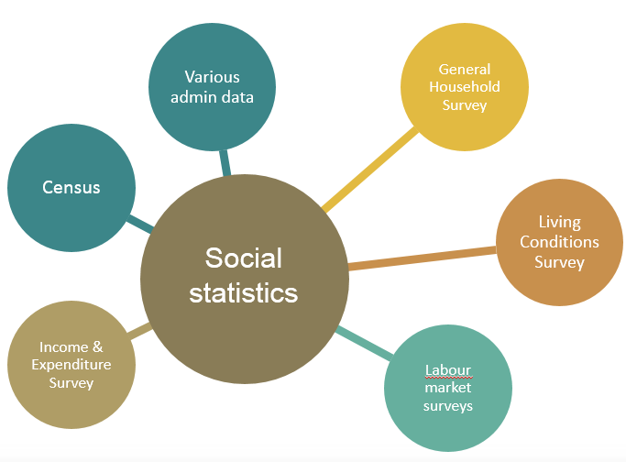
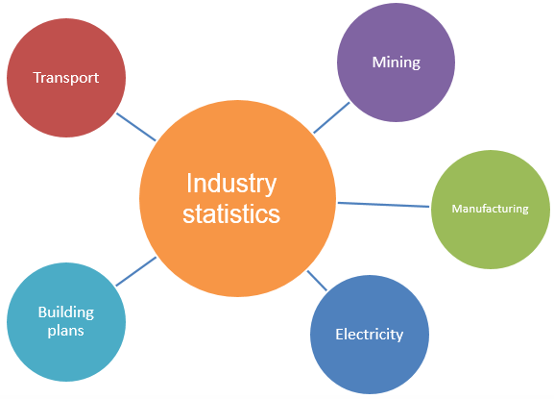
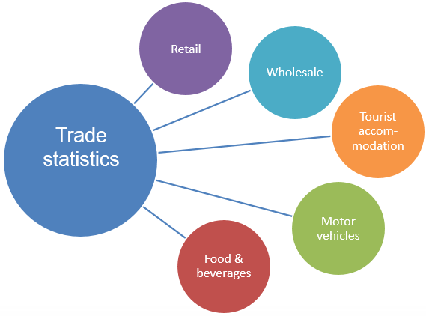
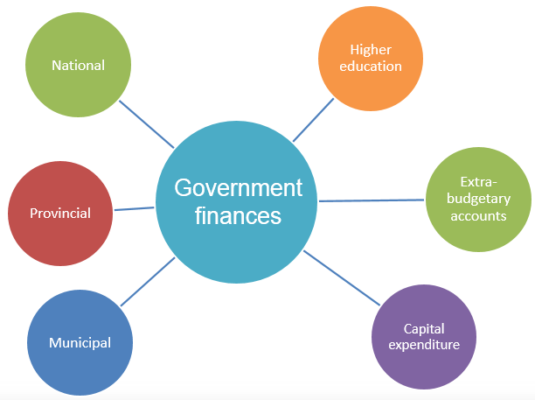
Stats SA publishes over 230 publications

Slide 4
Economic statistics production
is guided amongst others by:
Special Data Dissemination Standards (SDDS)
United Nations Principles of Official Statistics
South African Statistical Quality Assessment
Framework (SASQAF)
System of National Accounts 2008 etc.

Slide 5
Thus Stats SA plays two key roles
(1)
The production of official statistics
A coordination role within the NSS.

Slide 6
Coverage
Only 156 of the proposed 230 indicators have agreed standards and methods and can thus strictly speaking be measured.

Slide 7
Data availability varies by Goal
The 2016 baseline report, covers only 98 of the 156 indicators (63%), and the rest of the indicators in the report are additional domesticated indicators.
63%
Data Availability
61 - 80%
41 - 60%
21 - 40%
0 - 20%

Slide 8
The Sustainable Development Goals
And of the 98 indicators, only 21 of them are economic indicators.

Slide 9
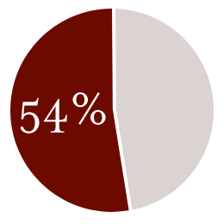
Problems
Lack of data to compile Economic indicators, was a challenge, with South Africa being unable to provide data on 49% of the SDG indicators from goal 8, 9 and 17.
46 %

Slide 10
Reasons
The objective of a functioning SANSS is to address the
Information gap
Quality
gap
Capacity gap

Slide 11
Reasons
Difference in definitions, method of computation and incoherent (measurement/ monitoring) systems within the country.
Lack of clarity in terms of what is required.

Slide 12
The SDG economic indicators
Indicator | Type
8.1.1 Annual growth rate of real GDP per capita | SDG
8.2.1 Annual growth rate of real GDP per employed person | SDG
8.5.2 Unemployment rate, by sex, age and persons with disabilities | SDG
8.7.1 Proportion and number of children aged 5 – 17 years engaged in child labour, by sex and age | Domesticated
8.8.1 Frequency rates of fatal and non-fatal occupational injuries, by sex and migrant status | SDG
9.5.1 Research and development expenditure as a percentage of GDP | SDG
17.1.2 Proportion of domestic budget funded by domestic taxes | SDG

Slide 13
The SDG economic indicators
8.1.1 Annual growth rate of real GDP per capita
Based on the time series, the data on the country page does to a certain extent output accurately as the official data, based on the common trend. But accuracy could be interpreted differently when taking into consideration one data point at a specific time interval.
1. Data Accuracy
Growth rate
2. Availability
Two data sources were used to compute this indicator, namely gross domestic product (GDP) and the mid-year population estimates (MYPE). The NSO provided these sources.

Slide 14
The SDG economic indicators
8.2.1 Annual growth rate of real GDP per employed person
1. Data Accuracy
The country page data seems not to be accurately matching the official data, with 2011 and 2013 points out of range when compared to those of official data.
Growth rate
2. Availability
Two data sources were used to compute this indicator, namely gross domestic product (GDP) and the Quarterly Labour Force Survey (QLFS). The NSO provided the data for both estimates.

Slide 15
The SDG economic indicators
8.5.2 Unemployment rate, by sex, age and persons with disabilities
1. Data Accuracy
Unemployment rate by sex (15+ years)
No data was supplied on the country page; hence, no comparisons.
2. Availability
The data source for this indicator is the Quarterly Labour Force Survey (QLFS) published by the NSO.

Slide 16
The SDG economic indicators
8.7.1 Proportion and number of children aged 5 – 17 years engaged in child labour, by sex and age
1. Data Accuracy
No data was supplied on the country page; hence, no comparisons.
Percentage of children aged 7–17 years engaged in child labour
2. Availability
The data source for this indicator is the Survey of Activities of Young People, published by the NSO.

Slide 17
The SDG economic indicators
8.8.1 Frequency rates of fatal and non-fatal occupational injuries, by sex and migrant status
1. Data Accuracy
Frequency rates of fatal and non-fatal occupational injuries of non-migrants by sex (per million)
No data was supplied on the country page; hence, no comparisons.
 | 2014 | 2015 | 2016
Male | 8 049 | 7 806 | 7 696
Female | 638 | 666 | 629
Total | 8 687 | 8 472 | 8 325
2. Availability
The data source for this indicator is the Umehluko database from the Department of Labour.

Slide 18
The SDG economic indicators
9.5.1 Research and development expenditure as a percentage of GDP
1. Data Accuracy
The country page data seems not to be accurately matching the Baseline Report , with 2010 to 2013 points extremely out of range when compared to those of official data.
2. Availability
The data source for this indicator is the Research and Development Survey (R&D Survey) published biannually by the Department of Science and Technology (DST).

Slide 19
The SDG economic indicators
17.1.2 Proportion of domestic budget funded by domestic taxes
1. Data Accuracy
Proportion of domestic budget funded by domestic taxes
Fiscal year | Domestic budget (R' million) | Domestic taxes (R' million) | Total domestic tax /domestic budget
2013/14 | 1 048 794 | 900 015 | 0,86
2014/15 | 1 133 304 | 986 295 | 0,87
2015/16 | 1 245 969 | 1 069 983 | 0,86
No data was supplied on the country page; hence, no comparisons.
2. Availability
The data source for this indicator is the Budget Review from National Treasury, which is published annually.

Slide 20
The SDG ICT indicators
8.10.2 Proportion of adults (15 years and older) with an account at a bank or other financial institution or with a mobile-money-service provider
9.c.1 Proportion of population covered by a mobile network, by technology
17.6.2 Fixed Internet broadband subscriptions per 100 inhabitants, by speed
17.8.1 Proportion of individuals using the Internet

Slide 21
Addressing the problem
Alignment
Priority setting
Addressing the gaps
More use of admin data

Slide 22
Addressing the problem
Alignment
Priority setting
Addressing the gaps
More use of admin data

Slide 23
Alignment
The SDGs have been aligned to the National Development Plan (NDP) and an integrated indicator framework has been developed that aligns indicators of the African Agenda 2063 and SDGs to the NDP
National Development Plan
IDP
DGDP
PGDP
MTSF
(Sector plans)
Regional
(SADC)
Special Groups
(BRICS)
Agenda
2063
SDG

Slide 24
Priority setting
The measurement process is primarily focused on the production of statistics for the National Development Plan (NDP).
Secondary focus will be data for other development agenda such as SADC, AU 2063, SDG etc.

Slide 25
Addressing the gaps : Data quality gap
To address the quality gap you need to measure the existing level of quality
SASQAF is the tool used in Stats SA to measure this.

Slide 26
Addressing the gaps : Information gap
Dept. of Water and Sanitation
Dept. of Education
Dept. of Home Affairs
Dept. of Health
INFORMATION GAP
The Integrated Indicator Framework is used to address the information gap.
Encourage greater use of administrative data

Slide 27
Challenges In Leaving No One Behind
Data disaggregation
Use of Admin data

Slide 28
Way forward
Improve institutions that collect data to go down to he lowest geographically levels.
Strengthening our data coordination capability through legislative reform.
Sector statistical plans to disaggregate data to much finer lower levels
3. Improve admin data so that the use of admin data increases.

