Slide 1

  Economic Statistics for Development in Tanzania: Mainstreaming SDGs in the National Statistical Systems
  Prepared by Daniel Masolwa and Ruth Minja

Slide 2
1. Introduction
Tanzania is implementing national development programmes and the SDGs;
Programmes include National Development Vision 2025, FYDP II 2016/17 -2020/21, The EAC agenda 2050, the Africa Agenda 2063 and the SDGs 2030;
Economic statistics is pivotal in evidence based policy formulation and development planning;
Setting of targets and means of achieving is made possible by use of economic statistics;

Slide 3
1. Introduction
Moreover, economic Statistics is used for monitoring and evaluations of programmes in a country;
The monitoring and evaluation is done to assess the impact of set policies and plans;
Tanzania is implementing the Sustainable Development Goals (SDGs) which are cross cutting in all sectors of the economy;
Policy formulation and development planning as part of implementing SDGs needs economic statistics;

Slide 4
1. Introduction – cont.
In order to assess the implementation of SDGs in Tanzania, a Sustainable Development Data Roadmap Process was introduced;
Sustainable Development Data Roadmap process has taught a lesson on how the available indicators can monitor national programs and track SDGs in Tanzania;
Few indicators are selected out of 36 Tier 1 Economic Indicators list to establish their relevancy with national programs;

Slide 5
2. Demand for economic statistics
Economic statistics is key in policy formulation and development planning;
Through economic statistics policy makers and planners use available statistical evidence as the production, consumption and distribution of goods and services is well understood;
Moreover, the level of technology, volume of production, exports and imports in policy formulation and planning need also to be understood;

Slide 6
2. Demand for economic statistics
Demand for economic statistics is however not met by the statistical systems due to the following challenges that need addressing:
  Existing systems are not harmonized;
  Definitional problem;
  Unavailability of indicators, not collected;
  Irregular frequency of data collection;
  Existence of data in “not easy to use format”

Slide 7
3. Monitoring Progress and SDGs Indicators
Tanzania developed a SDDR in 2016;
Its objective was to bring together all stakeholders to discuss data challenges and find solutions;
The forum identified existing data gaps and proposed for solution to fill in gaps;
Collaborators included GoT, Global Partnership for Sustainable Development Data, NBS, WB Group, PARIS 21, UNDP, MCC-PEPFAR collaborative and Tanzania Data Lab;

Slide 8
3. Monitoring Progress and SDGs Indicators
The focus of the roadmap is effective tracking of SDGs fostering partnership for improvement of data availability, accessibility and use with identified priority areas as:
  SDGs and FYDP II data gap assessment;
  Developing interactive National SDGs, EAC Vision 2050, Africa Agenda 2063 and FYDP II data visualization portal;
  High level engagement for formation of National Coordination mechanism on SDGs agenda;

Slide 9
3. Monitoring Progress and SDGs Indicators
Engagement of stakeholders to support data production and availability at national level where data gaps have been identified;
Create awareness session for high level officials to boost momentum of open data initiative;
Data capacity development (production, analysis and dissemination) in the government for MDAs;
It was revealed that of all indicators required for SDGs monitoring 40 percent are collected through Censuses and surveys while 60 percent are collected through routine data systems.

Slide 10
4. Indicators mainstreamed in the existing system
Assessment show strong alignment between SDGs and national development frameworks;
Out of the 244 SDGs indicators, 240 are potentially relevant with exception of 4 indicators that are not applicable to Tanzania;
Four indicators are not collected due to geographical focus.
Disaggregated data is presented in the figure below

Slide 11
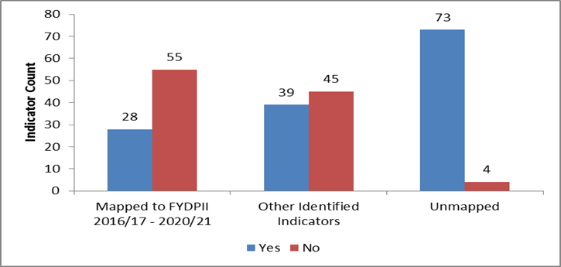
4. Indicators mainstreamed in the existing system

Slide 12
5. Challenges Facing Data Production the Process
Some of the existing challenges include:
Resource gaps
Capacity gaps
Limited political commitment; and
Weakness in stakeholders coordination

Slide 13
6. Recommendations for production of statistics
Development of Sustainable Development Data Roadmap process has provided useful lessons which include:
Establishing of National Coordination arrangements for SDGs implementation and monitoring;
Set up clear policy and procedural guidance for development of the national data ecosystem;
Put and keep the financing for data on the list of institutions and national priorities;

Slide 14
6. Recommendations for production of statistics
Building institutional knowledge base, collaboration and commitment within the National Statistical Office of drive the change;
Spreading knowledge and Awareness on SDGs and sustaining momentum;
Facilitating more comprehensive data capture from Administrative sources;
Engaging and working with sub-national Governments on the data for Development Agenda;

Slide 15
6. Recommendations for production of statistics
Establishing mechanism for smooth flow, access and use of data;
Building of a more comprehensive data base on statistics for Tanzania Mainland and Zanzibar; and
Collaboration with non-state actors and the International Data Community.

